Slide 1
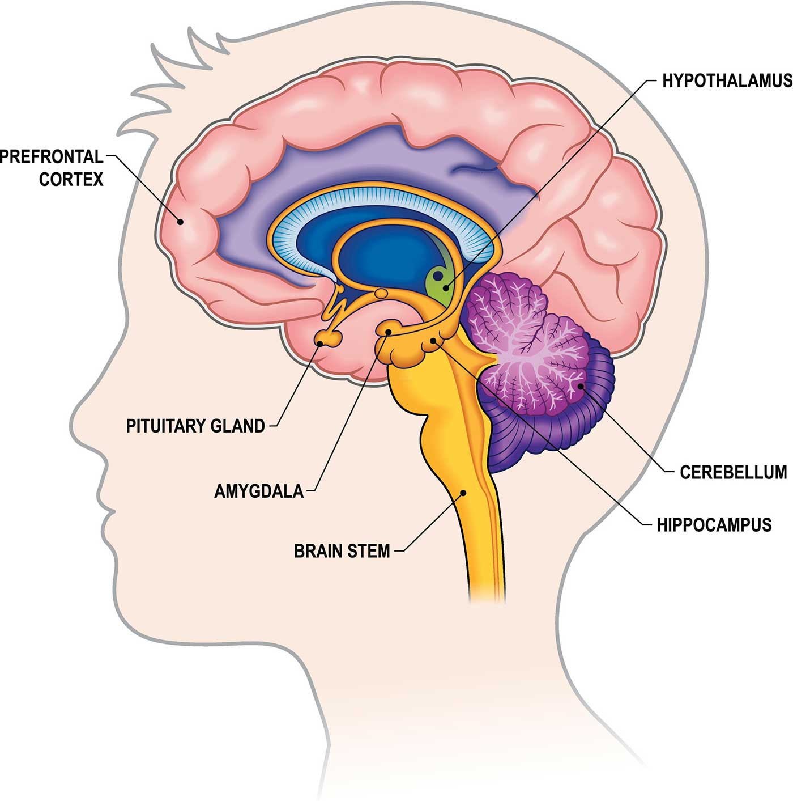
The AMYGDALA
is a part of the brain. Its job is to keep us safe; it therefore has to respond quickly.
It’s responsible for emotions & the memory of emotions
It’s responsible for the Fight Flight or Freeze response
When your Amygdala is “on” it hijacks the thinking part of your brain & you can’t learn, think straight, be reasonable or logical.
AMYGDALA

Slide 2
GROUNDNG TECHNIQUES Using your FIVE senses to calm yourself
IN YOUR BODY
Place your feet flat on the floor.
Starting at the crown of your head focus on your body bit by bit.
Pay attention to each section of your body and be aware of each tiny movement as you breath in and out slowly.
FIND
3 things you can see
3 things you can hear
3 things you can touch / feel
2 things you can smell
1 thing you can taste
DISTRACTION:
Name all the RED things you can see.
Count backwards by 3s from 100.
Recite a poem or sing a song you know.
Pick a category & name all the things you can
(dog breeds, different sports, hairstyles, hair colours, teachers you have had, food you like)

Slide 4
SELF REGULATION
Self Regulation is when we can tell how we are feelings & what we need to do to feel better.

Slide 5
THE DIVING REFLEX
Chew on a block of ice.
Use a cold cloth to apply to your face, forehead and back of your neck.
The use of COLD triggers the diving reflex which helps to calm us down by a series of physiological changes that take place in the body in response to a mammal holding its breath.
The diving reflex is triggered specifically by chilling and wetting the nostrils and face while breath-holding, and is sustained via neural processing ...
once your face is submerged in the cold water, nerves in your face are stimulated, sending a message to your vagus nerve. This tells the parasympathetic nervous system to “kick into gear,” which entails calming your body so it can relax and prepare to conserve energy

